Slide 1




Notes:
*

Slide 2


UI ENGINEERING STUDIO
UI Engineering Studio. Day 10 Bootcamp: React

Slide 3

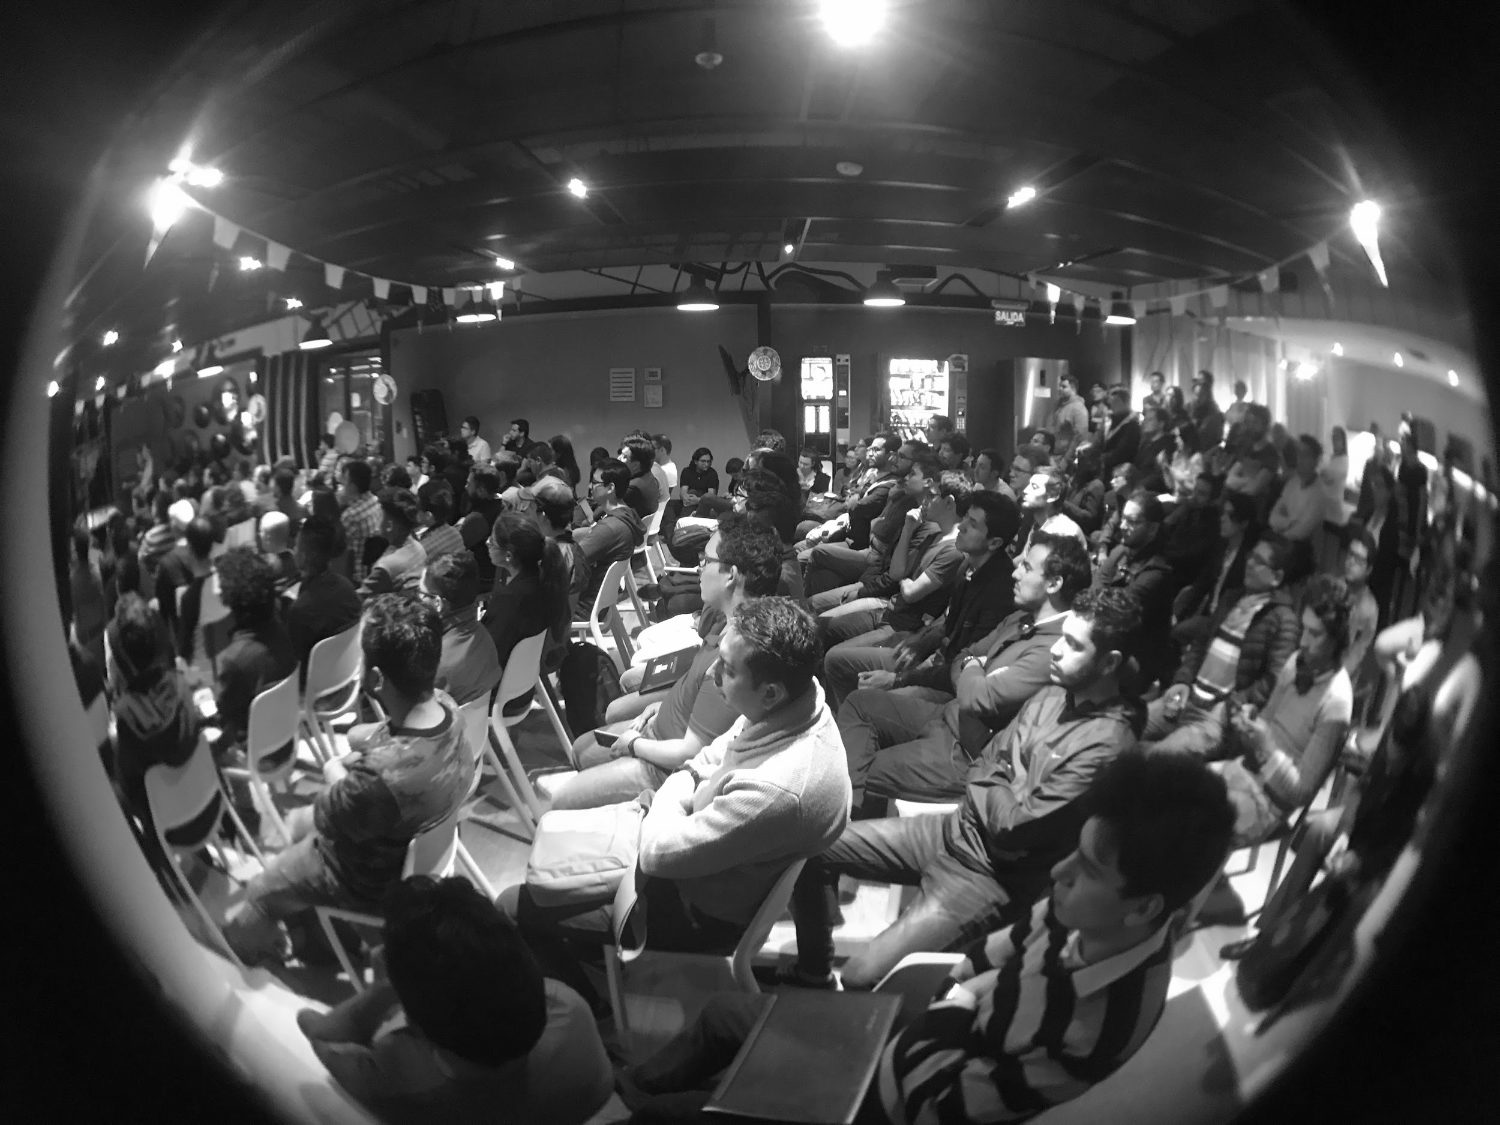
UI ENGINEERING STUDIO
React
is a declarative, efficient, and flexible JavaScript library for building user interfaces. It lets you compose complex UIs from small and isolated pieces of code called “components”
- https://reactjs.org
State and Props
LifeCycle
Exercises: Thinking in React

Slide 4
UI ENGINEERING STUDIO
UI Boot Camp: React State and Props: Props
A Property is:
Attribute
Quality
Characteristic
In React we called them props and we can access to them using this.props

Slide 5
UI ENGINEERING STUDIO
UI Boot Camp: React State and Props: Props
We have two useful objects:
defaultProps
propTypes
The component props can be defined by itself or can be passed by its parent

Slide 6
UI ENGINEERING STUDIO
UI Boot Camp: React State and Props: Props
https://codepen.io/anon/pen/WKzpzK
https://codepen.io/anon/pen/bjvWWJ
https://codepen.io/anon/pen/JBLNpr

Slide 7
UI ENGINEERING STUDIO
UI Boot Camp: React State and Props: State
For data that is going to change, we have to use state (dynamic data!)
Is it passed in from a parent via props? If so, it probably isn't state
Does it remain unchanged over time If so, it probably isn't state
Notes:
Nuestra aplicación únicamente tendrá un estado a la vez
Una vez actualizamos el estado de un componente este se va a renderizar con una nueva UI
State is similar to props, but it is private and fully controlled by the component.

Slide 8
UI ENGINEERING STUDIO
UI Boot Camp: React State and Props: State
Some useful things here:
getInitialState
setState(data, callback)
User inputs
Event handlers

Slide 9
UI ENGINEERING STUDIO
UI Boot Camp: React State and Props: State
https://codepen.io/anon/pen/pZLwye?editors=1010

Slide 10
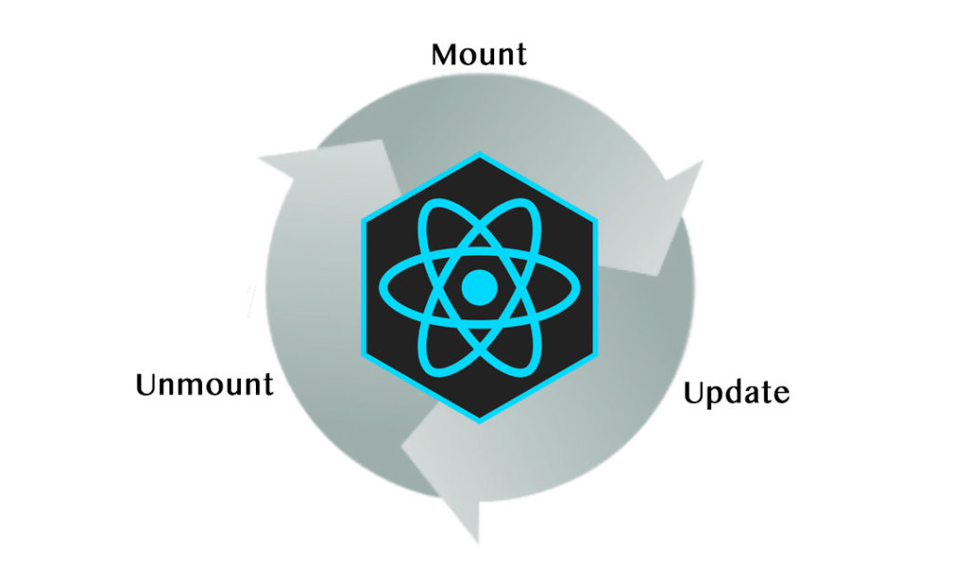
UI ENGINEERING STUDIO
UI Boot Camp: React LifeCycle

Slide 11
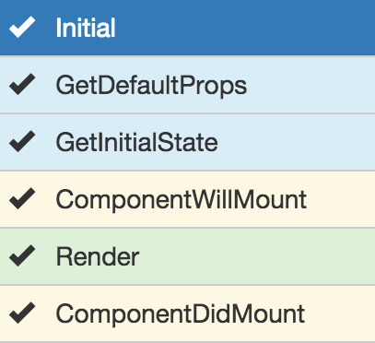
UI ENGINEERING STUDIO
UI Boot Camp: React LifeCycle - Mounting
Notes:
Se ejecuta cuando un componente va a ser insertado al DOM
componentWillMount: Setear un estado en esta fase no volverá a lanzar un re-render
Render: NO modificar state ni props
componentDidMount: Cualquier interacción con el DOM debe ser ejecutada en esta fase

Slide 12
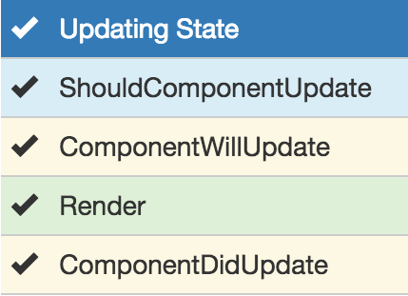
UI ENGINEERING STUDIO
UI Boot Camp: React LifeCycle - Updating: State
Notes:
Se ejecuta cuando se actualiza el estado de un componente
UNSAFE_componentWillUpdate()
componentWillUpdate: Cambios de estado no son permitidos

Slide 13
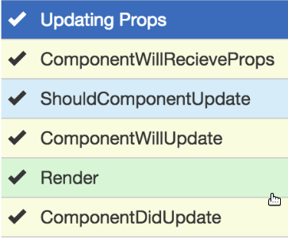
UI ENGINEERING STUDIO
UI Boot Camp: React LifeCycle - Updating: Props
Notes:
Se ejecuta cuando se le envían nuevas props a un component
UNSAFE_componentWillReceiveProps()
componentWillReceiveProps: Se pueden hacer cambios de estado basados en las props actuales y las que llegan

Slide 14
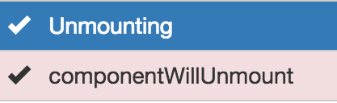
UI ENGINEERING STUDIO
UI Boot Camp: React LifeCycle - Unmounting
Notes:
Se ejecuta cuando un componente va a ser eliminado delDOM

Slide 15
UI ENGINEERING STUDIO
UI Boot Camp: React LifeCycle
https://codepen.io/sebas_alarcon/pen/yEEgQm
Notes:
UNSAFE_componentWillReceiveProps()

Slide 16

UI ENGINEERING STUDIO
UI Boot Camp: React Exercises: Thinking in React - States of water

Slide 17

UI ENGINEERING STUDIO
UI Boot Camp: React Exercises: Thinking in React - States of water
Ice Water Steam

Slide 18
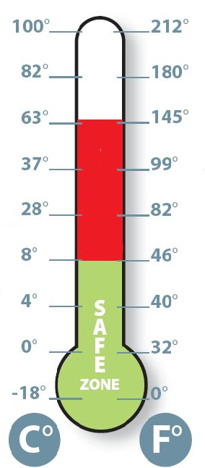
UI ENGINEERING STUDIO
UI Boot Camp: React Exercises: Thinking in React - States of water
TEMPERATURE 100°C |_ |_ |_ |_ |_ |_ | 0°C
STATE GAS LIQUID SOLID

Slide 19
UI ENGINEERING STUDIO
UI Boot Camp: React Exercises: Thinking in React - States of water
https://codepen.io/luribeto/pen/JKjVPE

Slide 20
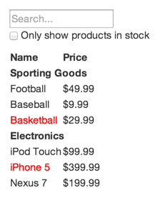
UI ENGINEERING STUDIO
UI Boot Camp: React Exercises: Thinking in React - Identifying Components
Notes:
Imaginemos que tenemos un JSON API y un mock de nuestro diseñador. Aparentemente no es tan bueno, porque el mock luce así

Slide 21
UI ENGINEERING STUDIO
UI Boot Camp: React Exercises: Thinking in React - Identifying Components
[ {category: "Sporting Goods", price: "$49.99", stocked: true, name: "Football"}, {category: "Sporting Goods", price: "$9.99", stocked: true, name: "Baseball"}, {category: "Sporting Goods", price: "$29.99", stocked: false, name: "Basketball"}, {category: "Electronics", price: "$99.99", stocked: true, name: "iPod Touch"}, {category: "Electronics", price: "$399.99", stocked: false, name: "iPhone 5"}, {category: "Electronics", price: "$199.99", stocked: true, name: "Nexus 7"} ];
Notes:
Imaginemos que el JSON API retorna una data que se ve así

Slide 22
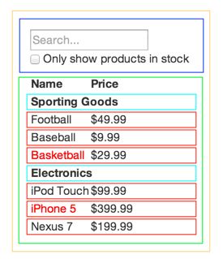
UI ENGINEERING STUDIO
UI Boot Camp: React Exercises: Thinking in React - Identifying Components
FilterableProductTable (orange): contains the entirety of the example
SearchBar (blue): receives all user input
ProductTable (green): displays and filters the data collection based on user input
ProductCategoryRow (turquoise): displays a heading for each category
ProductRow (red): displays a row for each product
FilterableProductTable
SearchBar
ProductTable
ProductCategoryRow
ProductRow
Notes:
Vista jerárquica

Slide 23

UI ENGINEERING STUDIO
UI Boot Camp: React Homework!
We’re going to continue with the TODO list.
Let’s put some life to those components: Implement States, Props and LifeCycle

Slide 24
Notes:
*

